Slide 1
Implementation of Apriori Algorithm using python modules : mlxtend and efficient_apriori on Groceries Dataset in jupyter notebook .
Prepared by :

Slide 2
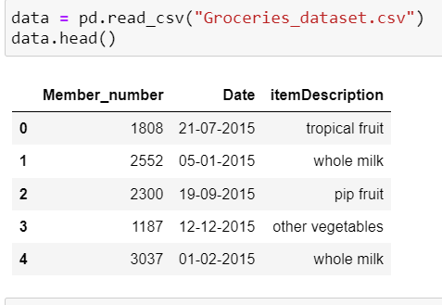
DATASET
Dataset used for this implementation was picked from kaggle via https://www.kaggle.com/heeraldedhia/groceries-dataset
Dataset included the details like customer id , date
of purchase and item name. Data needed to be processed
To find out which items was bought together by each
customer.

Slide 3
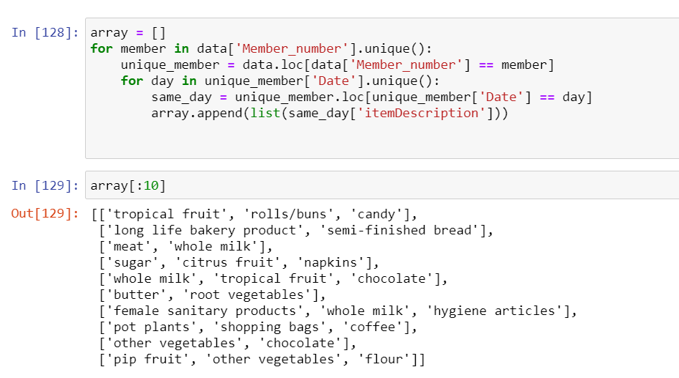
DATASET Processing
After processing data, a list of items i.e.array
was created such that all items that
was bought on same day by same
customer was grouped.
This list is now ready to be applied
Apriori Algorithm for checking
Association rules between items.

Slide 4
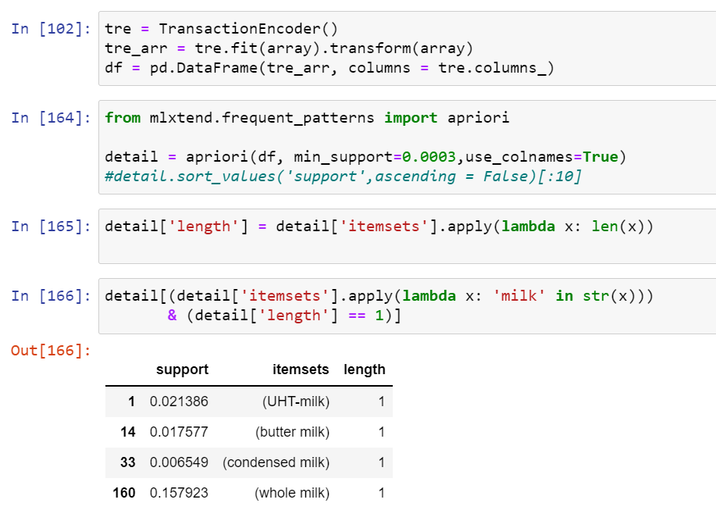
Association Rules
MULTI LEVEL ASSOCIATION
The support values of different milk items as shown by Out[166] demonstrates the rule of multi level association. If we combine all types of milk and calculate the support it will be the sum of support of all types of milk.
Hence support is reduced from Milk as a whole to different milk types.
*Using mlxtend

Slide 5
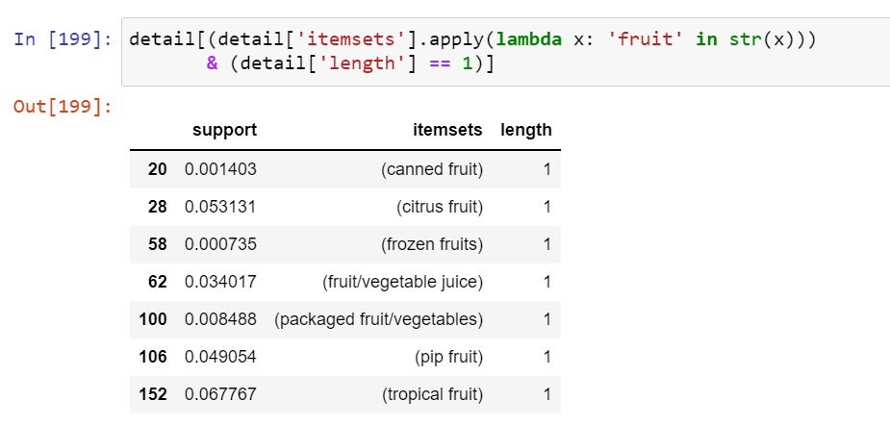
Testing multilevel association by changing attribute or item

Slide 6
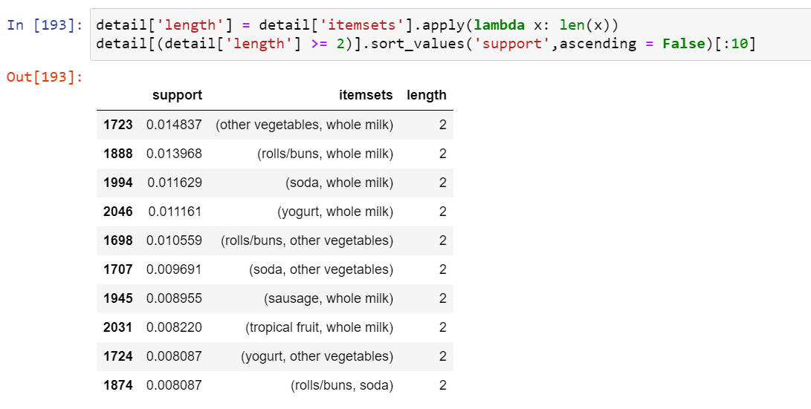
Output below shows top 10 frequently bought pairs of items with corresponding support values.
*using mlxtend

Slide 7
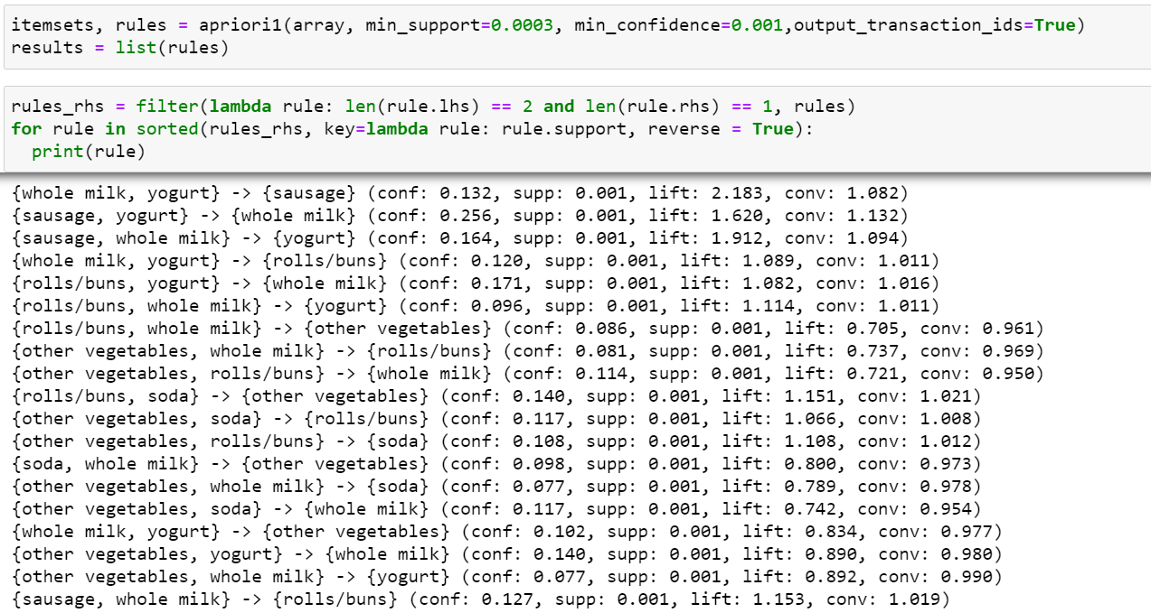
Association Rules
MULTI Dimensional ASSOCIATION using efficient_apriori module
It shows how the purchase of multiple items are associated with the purchase of unique item. Eg. purchase of sausage, yougurt and whole milk is associated as shown by first four lines of output.
*using efficient_apriori

Slide 8
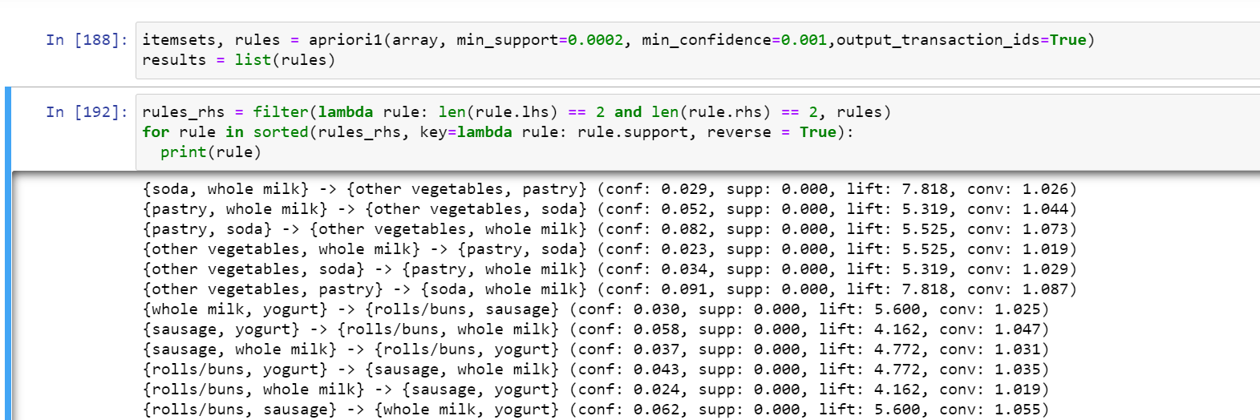
We can see the association of purchase of more than two items too.
First four lines of output shows how much is it likely that four items i.e. soda, whole milk, vegetables and pastry are purchased together.
*using efficient_apriori

Slide 9
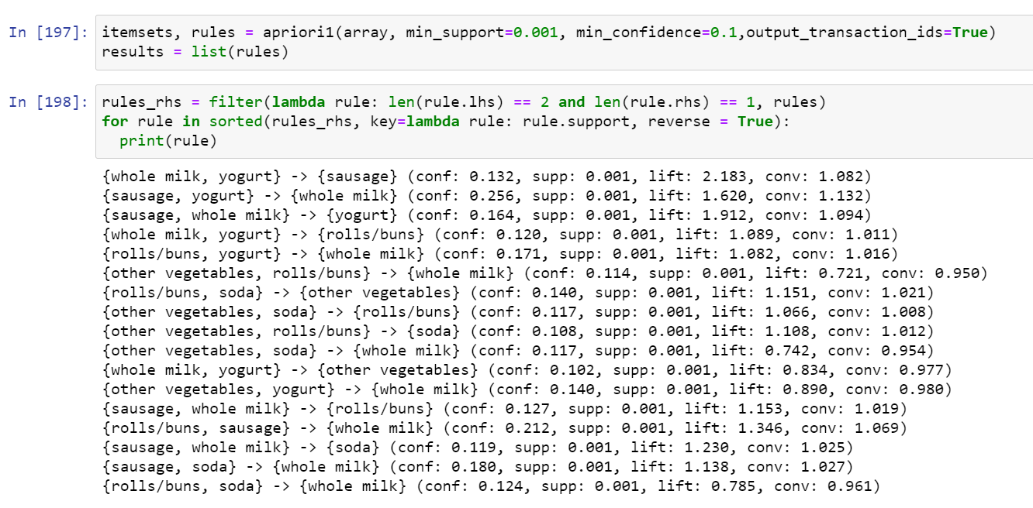
Altering support and confidence threshold

Slide 10
CONCLUSIONS
To conclude the analysis, it is clear that Apriori algorithm is helpful in determining association rules with the categorical datasets. Metrics such as support and confidence helped to determine the association between the purchase of items. In groceries dataset that is used for analysis, as expected in multilevel association rule the lower levels( milk-types or fruit types) was found to have lower support.
Similarly the association of more than two items with each other shows that multi dimensional association rule is also relevant with the groceries dataset. Correlations was also seen among different items.
The data obtained from analysis could be use in the grocery store to place the most frequently bought items together to improve the sales.

